Slide 1
How to Join the Infosec Community
Micah Hoffman

Slide 2
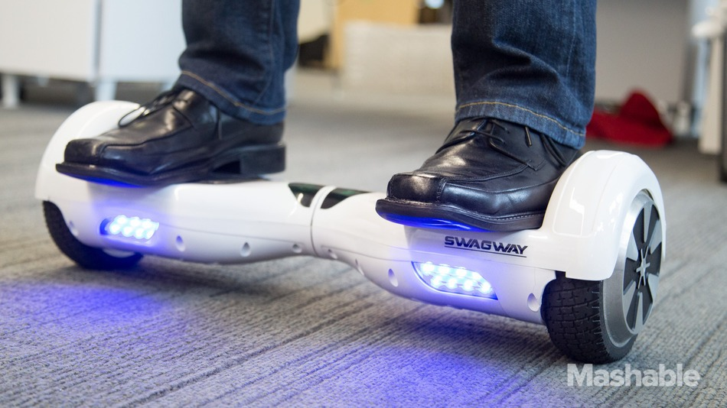
http://rack.1.mshcdn.com/media/ZgkyMDE1LzEyLzI1LzViL1N3YWd3YXlUSFVNLjllNzQyLmpwZwpwCXRodW1iCTk1MHg1MzQjCmUJanBn/310b9d37/34a/Swagway-THUMBNAIL-1.jpg

Slide 3

http://www.google.com/selfdrivingcar/images/home-where.jpg

Slide 4
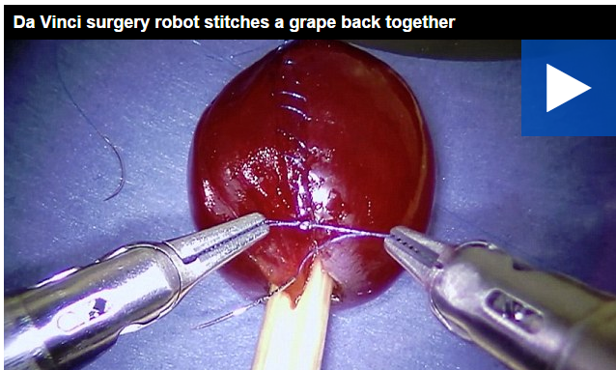
http://www.dailymail.co.uk/video/news/video-1182603/Da-Vinci-surgery-robot-stitches-grape-together.html

Slide 5
I'm a
Senior Person

Slide 6
People ask me,
“How do I cyber?”

Slide 7
Infosec Industry
vs.
Infosec Community

Slide 8
In the DC Area,
More infosec Jobs than People

Slide 9
But some jobs
require experience

Slide 10
Top 12 Tips for
Joining the
Infosec Community

Slide 11
Community Tip #1
Get Experience

Slide 12
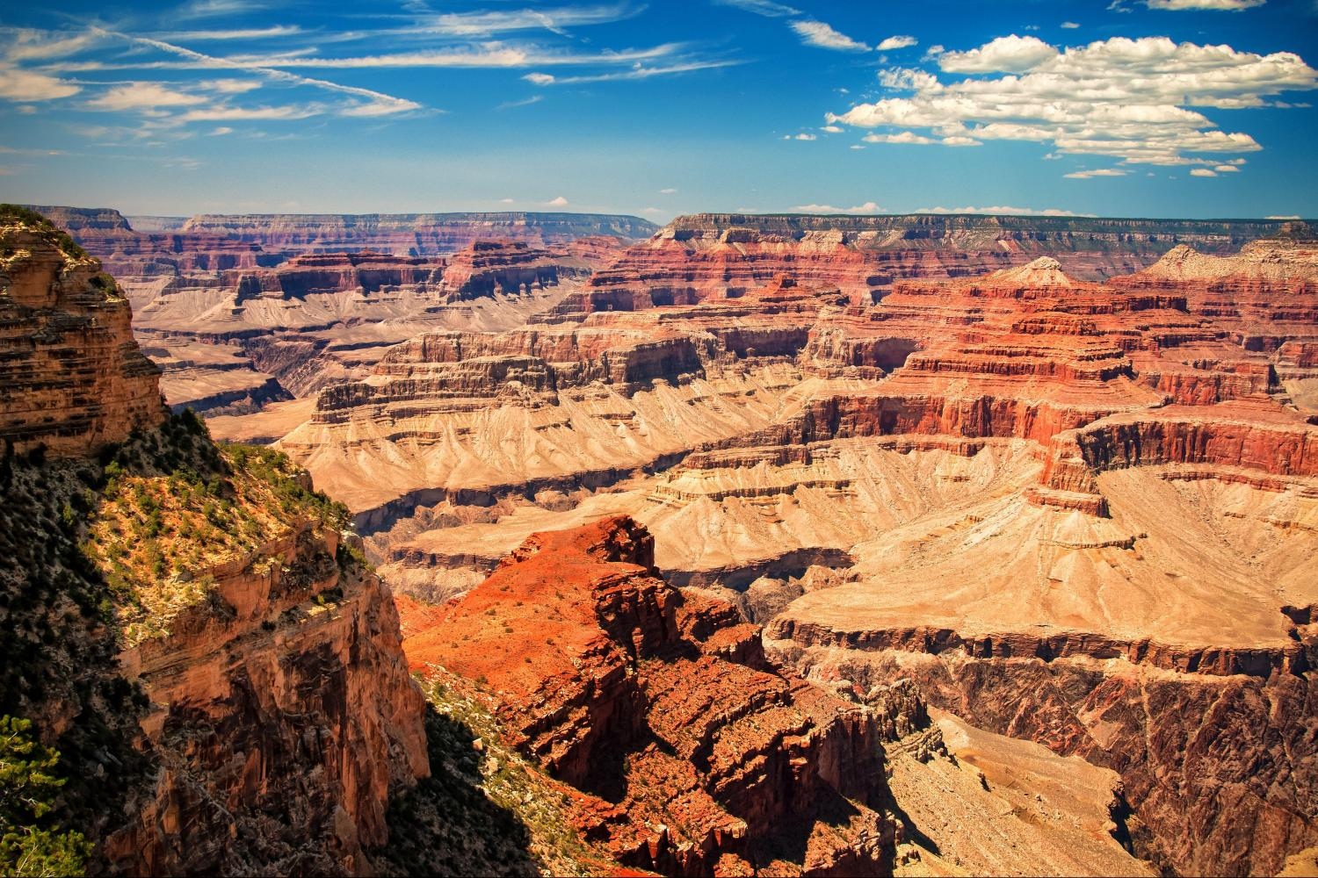
http://a30de2edae0c4b0bc6ba-a8477a60b1c5d9e290ed2e4c0d53743c.r24.cf1.rackcdn.com/2/5/large.jpg

Slide 13
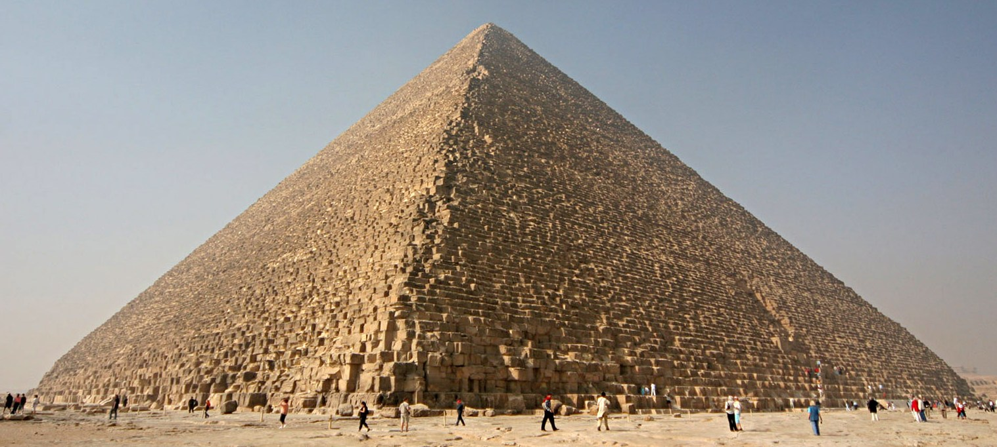
Infosec
Other Experiences
https://upload.wikimedia.org/wikipedia/commons/e/e3/Kheops-Pyramid.jpg

Slide 14
Infosec
Other Experiences
https://upload.wikimedia.org/wikipedia/commons/e/e3/Kheops-Pyramid.jpg

Slide 15
Some experiences
will not be fun

Slide 16
All experiences
build YOU

Slide 17
Community Tip #2
Take Control
Of Your
(Self) Learning

Slide 18
YouTube
Wikis, Blogs
Capture The Flags (CTFs)

Slide 19

https://www.sans.org/images/locations/us/ca/san-diego/hard-rock-hotel/cyber-defense-logo.jpg

Slide 20

http://www.careerealism.com/wp-content/uploads/2010/12/12.09.10-1-Way-to-Get-a-New-Job-in-2011-Featured.png

Slide 21
Information
Security
Professional

Slide 22
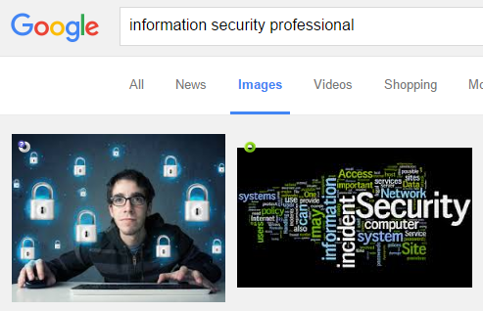
https://www.google.com/search?newwindow=1&biw=1781&bih=764&site=imghp&tbm=isch&sa=1&q=information+security+professional&oq=information+security+professional&gs_l=img.3..0i30k1l2j0i24k1l8.56681.63060.0.63231.41.25.3.12.12.0.168.2550.16j9.25.0....0...1c.1.64.img..1.34.2323...0j0i67k1j0i8i30k1.A9I9hKwRFW8

Slide 23

https://empowered-partnerships.com/wp-content/uploads/2015/10/92-S-SHUTTERSTOCK_183043784.jpg

Slide 24
CISSP®

Slide 25

http://weknowyourdreamz.com/images/happy/happy-03.jpg

Slide 26
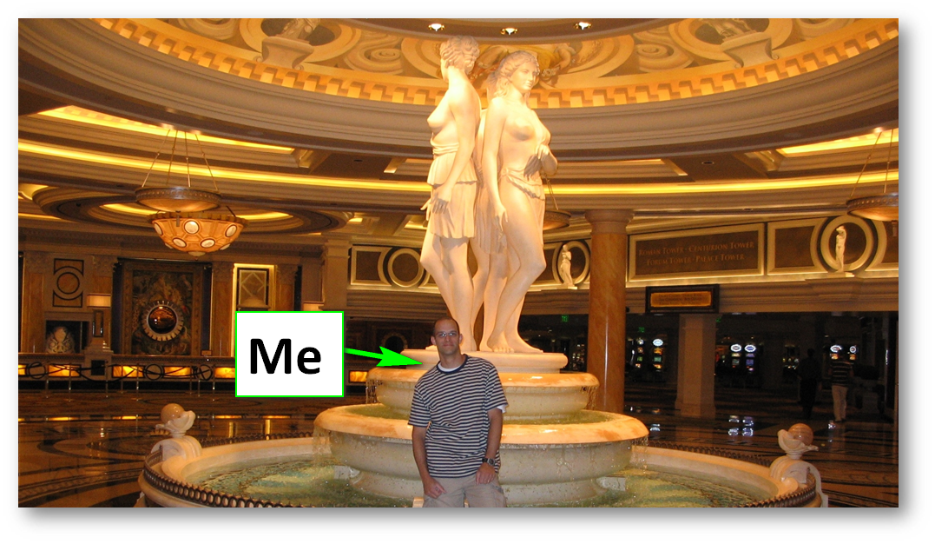

Slide 27
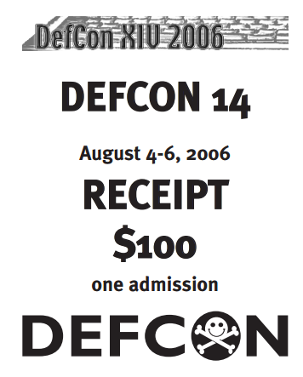
https://www.defcon.org/images/defcon-14/dc-14-receipt-single.pdf

Slide 28

http://www.weareunleashed.com/wp-content/uploads/2013/02/021813_1344_HackthePlan1.jpg

Slide 29

http://2.bp.blogspot.com/-dMYyWb2DywU/U1LJZdIVGaI/AAAAAAAAALY/y0Gli4FY4Wg/s1600/russian-hacker.jpg

Slide 30

http://www.famlii.com/wp-content/uploads/2014/08/Boy-looking-through-telescope-in-desert.jpg

Slide 31
Community Tip #3
Join a Group

Slide 32


novahackers.com
Northern VA/DC/MD
unallocatedspace.org
Baltimore, MD

Slide 33

ISSA
Information Systems Security Association
http://www.issa.org/?chapterNorthAmerica

Slide 34
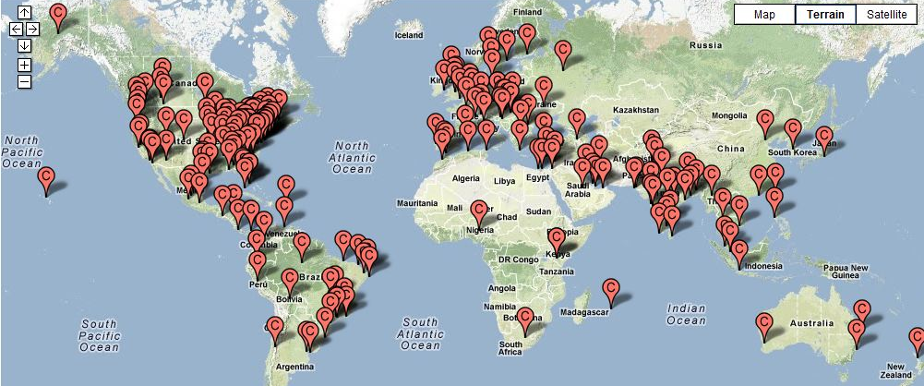
OWASP Local Chapters
www.owasp.org/index.php/OWASP_Local_Chapters

Slide 35
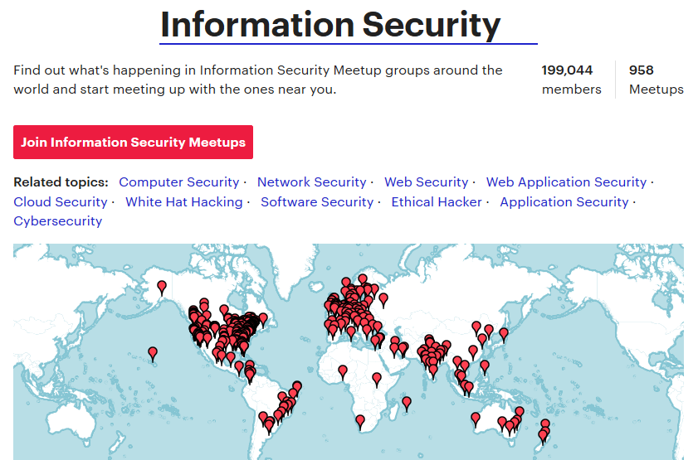
www.meetup.com/topics/information-security/

Slide 36
"Everyone knows
what I know."

Slide 37

https://adanders.wp.d.umn.edu/fa15sec3/wp-content/uploads/sites/25/2015/09/billnyequote.jpg

Slide 38
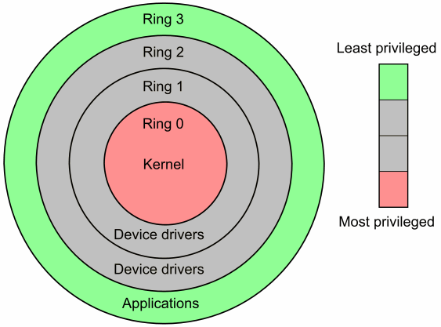
https://blog.codinghorror.com/content/images/uploads/2008/01/6a0120a85dcdae970b0120a86db3ea970b-pi.png

Slide 39
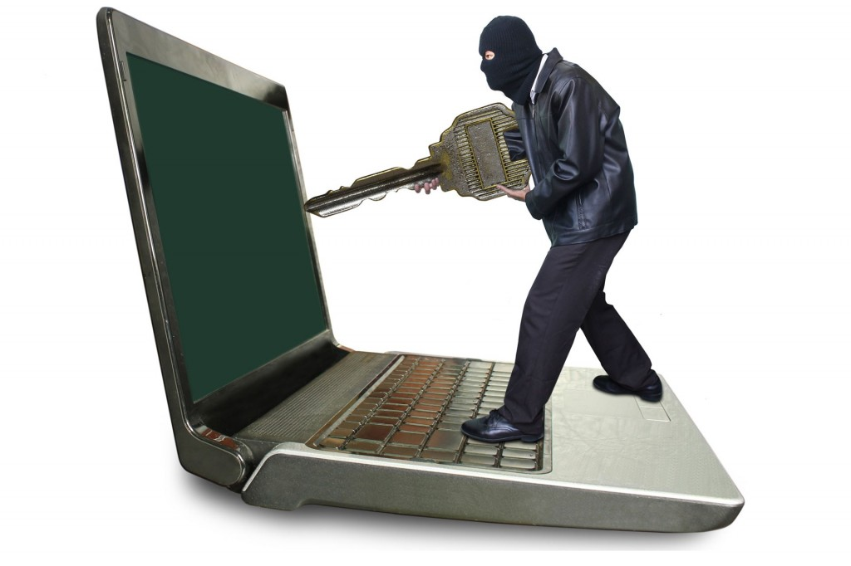
http://www.coastdigital.co.uk/wp-content/uploads/2015/04/hacking-1024x682.jpg

Slide 40
Community Tip #4
Set Goals
for Yourself

Slide 41
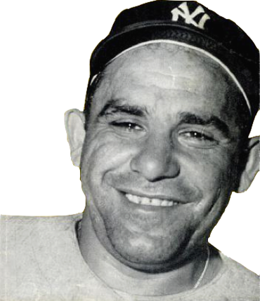
“If you don't know where you're going, you might not get there.”
https://en.wikiquote.org/wiki/Yogi_Berra

Slide 42
Community Tip #5
Contribute to
Open Source Projects

Slide 43
I Learned Python

Slide 44
"But Micah,
I am not a
programmer!"

Slide 45
https://github.com/WebBreacher/offensiveinterview
https://github.com/fuzzdb-project/fuzzdb
https://github.com/lockfale/OSINT-Framework
*If you can Notepad, you can contribute!

Slide 46
Community Tip #6
Attend and Participate at
Infosec Conferences

Slide 47




Slide 48

http://toool.us/resources.html

Slide 49


Slide 50
Talk to the
Speakers

Slide 51
Community Tip #7
Blog or Podcast

Slide 52

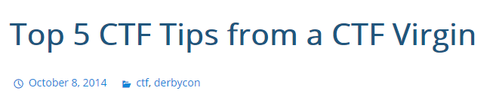
https://webbreacher.com/2014/10/08/top-5-ctf-tips-from-a-ctf-virgin/

Slide 53
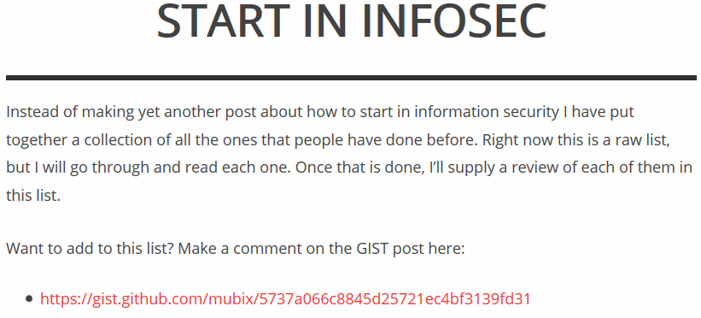
https://room362.com/start/

Slide 54
Community Tip #8
Volunteer

Slide 55
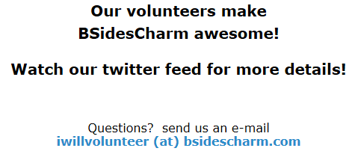
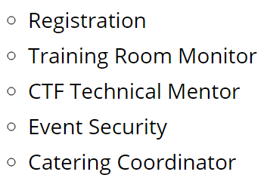

Slide 56
Community Tip #9
Ask for and
Take Feedback

Slide 57
"Most people do not listen
with the intent to understand;
they listen with the intent to reply."
Stephen R. Covey
The 7 Habits of Highly Effective People

Slide 58


Slide 59

https://webbreacher.com/2015/06/03/we-are-running-away-from-security/

Slide 60
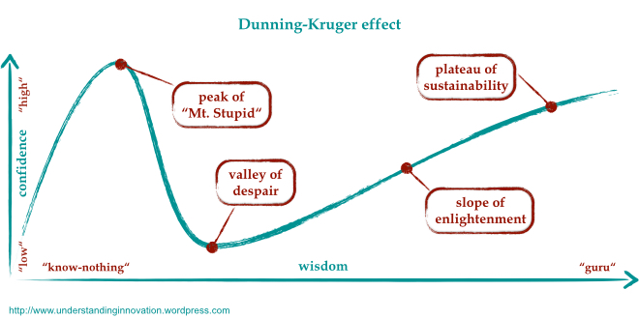
Notes:
https://wisdomofhands.blogspot.com/2015/12/the-peak-of-mount-stupid.html, February 25, 2017.

Slide 61
Community Tip #10
Track Your
Progress

Slide 62
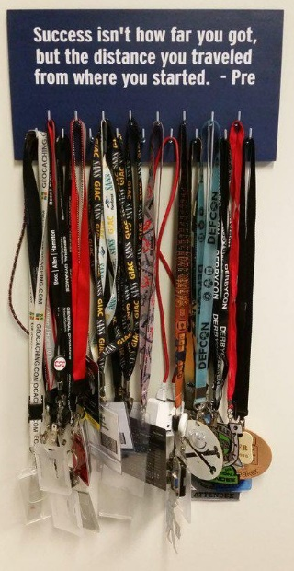
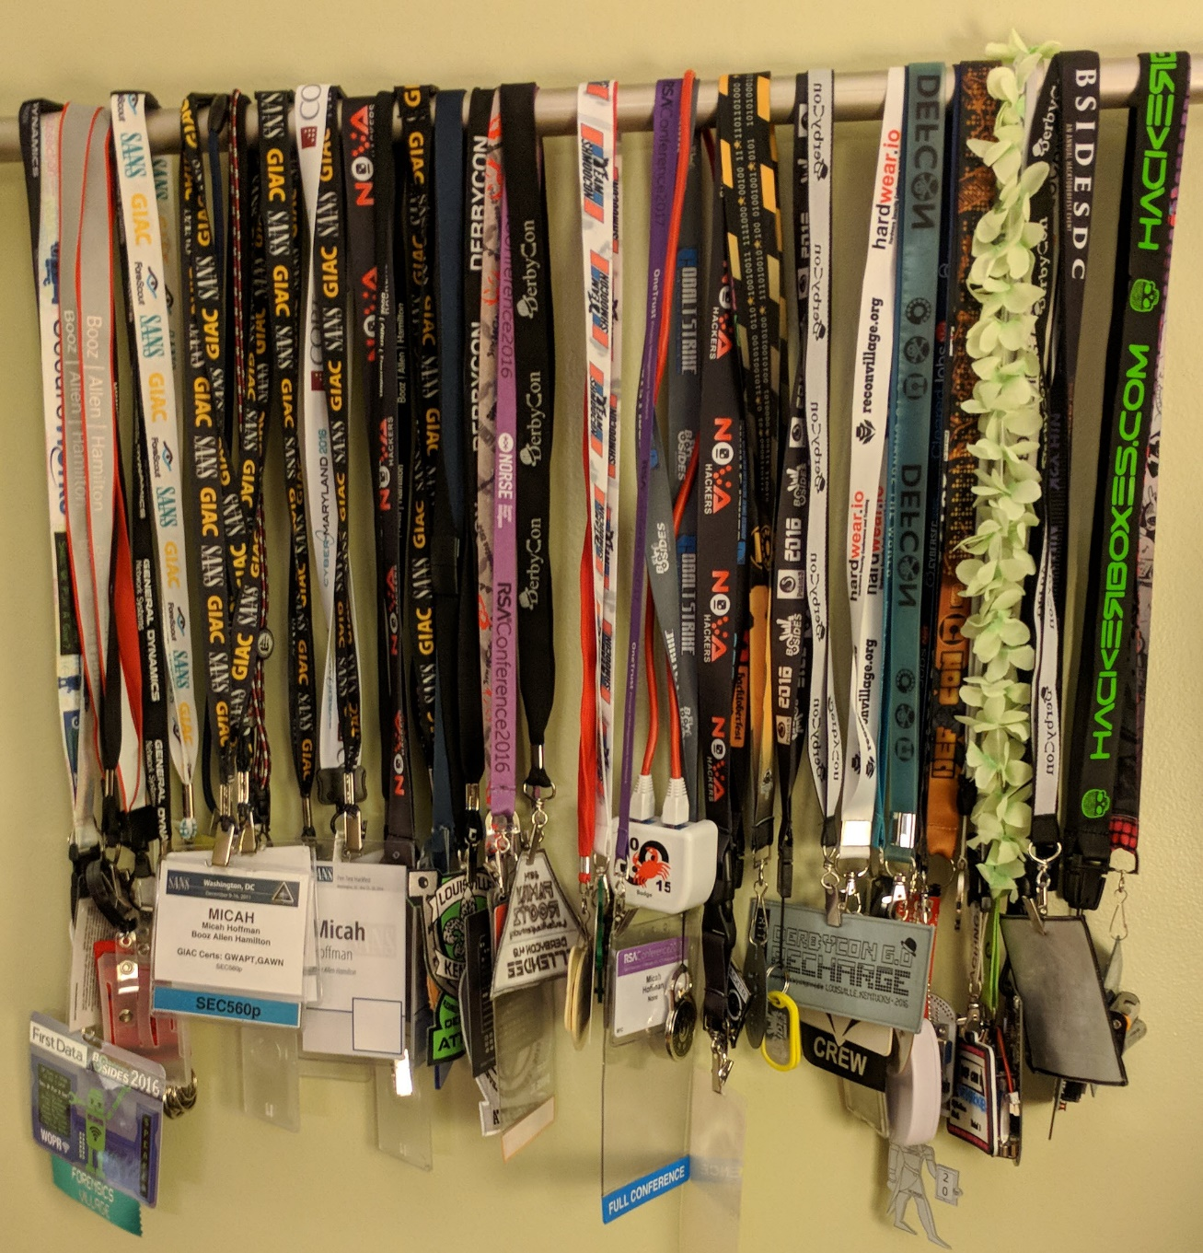

Slide 63
Community Tip #11
Join Twitter

Slide 64
#infosec
@WebBreacher

Slide 65
Community Tip #12
Realize Not Everyone is Like You

Slide 66
How do you infosec?
Hobbyist?
Worker?
Immersed/Lifestyle?

Slide 67
We need and welcome
all people in the
infosec community.

Slide 68
How to Join the Infosec Community
Get Experience
Take Control
Join a Group
Set Goals
Contribute to FOSS
Attend and Participate at Infosec Conferences
Blog / Vlog / Podcast
Volunteer
Share Knowledge
Track Your Progress
Join Twitter
Not Everyone is Like You (and that's a good thing!)

